Slide 1
Virtual Memory
Course Instructor: Nausheen Shoaib

Slide 2
Definition of Virtual Memory [1/2]
Virtual memory is a memory management capability of an OS
uses hardware and software to allow a computer to compensate for physical memory shortages by temporarily transferring data from random access memory (RAM) to disk storage.

Slide 3
Definition of Virtual Memory [2/2]
VIrtual memory is not RAM (Random access memory) on memory chips.
Virtual memory is an area of hard drive or other storage space, which OS uses as swap space (overflow) for the physical RAM. When the demands of the software and data exceed the physical RAM size, the operating system copies to hard disk blocks of data from RAM that have been seldom used, and releases that RAM for use by the current process.
When the block (or Page) is required again, the OS makes room in RAM by copying another block to hard drive and copying in the data from the first block.

Slide 4
Background
Virtual memory – separation of user logical memory from physical memory
Only part of the program needs to be in memory for execution
Logical address space can therefore be much larger than physical address space
Allows address spaces to be shared by several processes
Allows for more efficient process creation
More programs running concurrently
Less I/O needed to load or swap processes
Virtual memory can be implemented via:
Demand paging
Demand segmentation

Slide 5
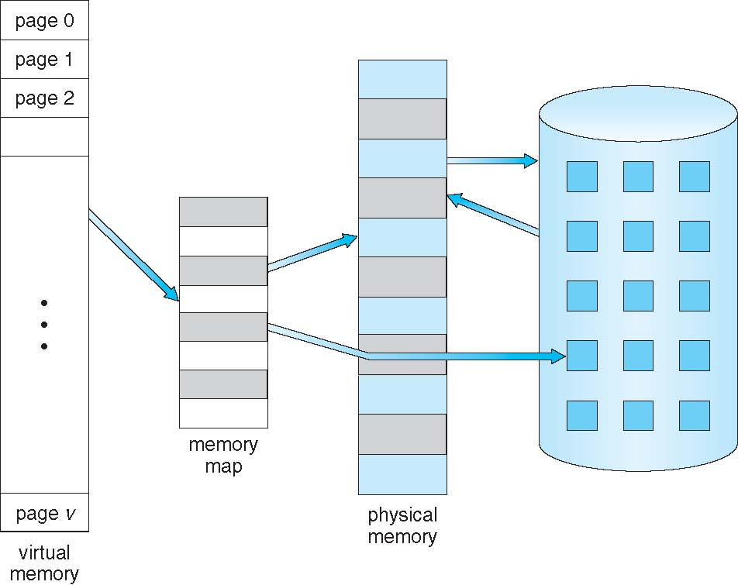
Virtual Memory That is Larger Than Physical Memory

Slide 6
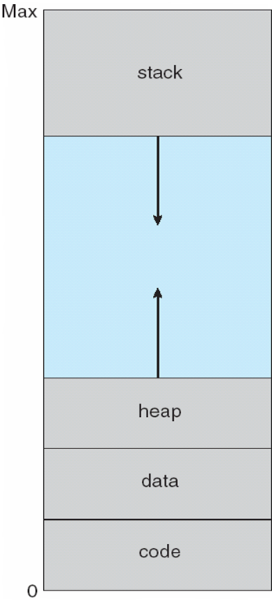
Virtual-address Space

Slide 7
Virtual Address Space
Virtual address spaces that include holes are known as sparse address spaces.
System libraries shared via mapping into virtual address space
Shared memory by mapping pages read-write into virtual address space
Pages can be shared during fork(), speeding process creation

Slide 8
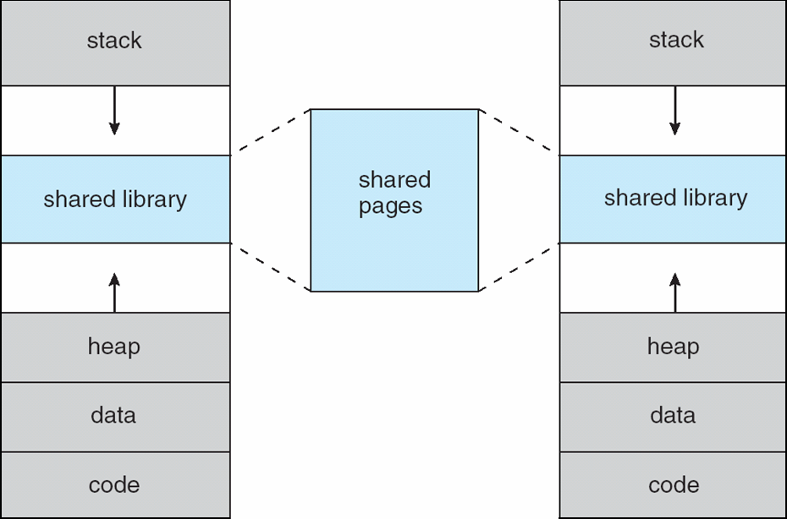
Shared Library Using Virtual Memory

Slide 9
Demand Paging
Could bring entire process into memory at load time
Or bring a page into memory only when it is needed
Less I/O needed, no unnecessary I/O
Less memory needed
Faster response
More users
Page is needed ⇒ reference to it
invalid reference ⇒ abort
not-in-memory ⇒ bring to memory
Lazy swapper – never swaps a page into memory unless page will be needed
Swapper that deals with pages is a pager

Slide 10
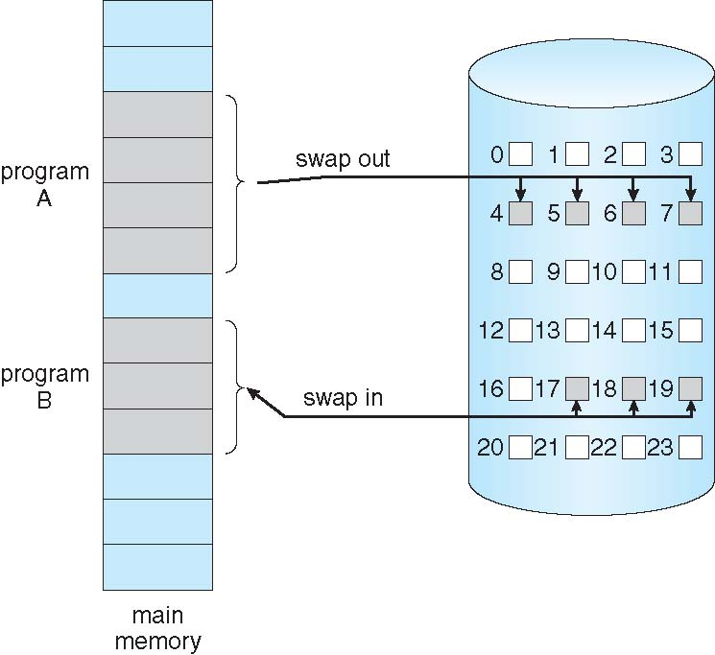
Transfer of a Paged Memory to Contiguous Disk Space

Slide 11
Valid-Invalid Bit
With each page table entry a valid–invalid bit is associated (v ⇒ in-memory – memory resident, i ⇒ not-in-memory)
Initially valid–invalid bit is set to i on all entries
Example of a page table snapshot:
During address translation, if valid–invalid bit in page table entry is I ⇒ page fault
Frame #
valid-invalid bit
v
v
v
i
….
page table
i
i

Slide 12
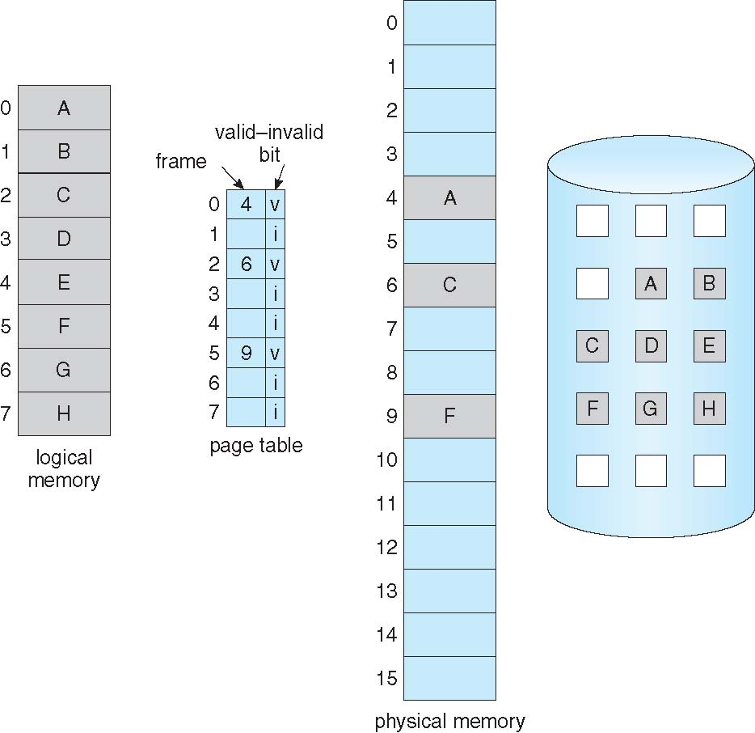
Page Table When Some Pages Are Not in Main Memory

Slide 13
Page Fault
If there is a reference to a page, first reference to that page will trap to operating system:
page fault
Operating system looks at another table to decide:
Invalid reference ⇒ abort
Just not in memory
Get empty frame
Swap page into frame via scheduled disk operation
Reset tables to indicate page now in memory Set validation bit = v
Restart the instruction that caused the page fault

Slide 14
Aspects of Demand Paging
Extreme case – start process with no pages in memory
OS sets instruction pointer to first instruction of process, non-memory-resident -> page fault
And for every other process pages on first access
Pure demand paging
Actually, a given instruction could access multiple pages -> multiple page faults
Pain decreased because of locality of reference
Hardware support needed for demand paging
Page table with valid / invalid bit
Secondary memory (swap device with swap space)
Instruction restart

Slide 15
Instruction Restart
Consider an instruction that could access several different locations
block move
auto increment/decrement location
Restart the whole operation

Slide 16
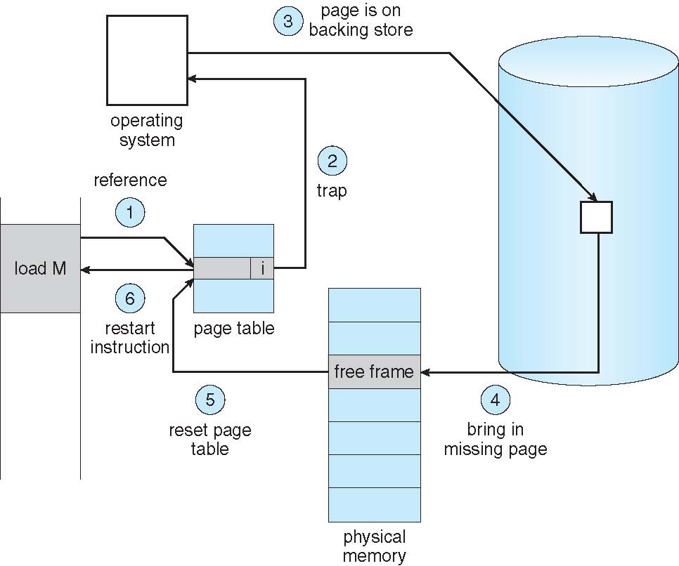
Steps in Handling a Page Fault

Slide 17
Performance of Demand Paging
Stages in Demand Paging
Trap to the operating system
Save the user registers and process state
Determine that the interrupt was a page fault
Check that the page reference was legal and determine the location of the page on the disk
Issue a read from the disk to a free frame:
Wait in a queue for this device until the read request is serviced
Wait for the device seek and/or latency time
Begin the transfer of the page to a free frame
While waiting, allocate the CPU to some other user
Receive an interrupt from the disk I/O subsystem (I/O completed)
Save the registers and process state for the other user
Determine that the interrupt was from the disk
Correct the page table and other tables to show page is now in memory
Wait for the CPU to be allocated to this process again
Restore the user registers, process state, and new page table, and then resume the interrupted instruction

Slide 18
Performance of Demand Paging (Cont.)
Page Fault Rate 0 ≤ p ≤ 1
if p = 0 no page faults
if p = 1, every reference is a fault
Effective Access Time (EAT)
effective access time = (1 − p) × ma + p × page fault time.

Slide 19
Performance of Demand Paging (Cont.)
Memory Access Time = 200 nanoseconds
Average page fault service time = 8 millisecond
If one access out of 1,000 causes a page fault, then p=1/1000=0.001
effective access time = (1 − p) × ma + p × page fault time.
EAT= (1-0.001)*200+(0.001* 8e-6)
= 8199.8 nanosecond
= 8.199 microsecond
Millisecond = 10e-3
Microsecond =10e-6
Nanosecond = 10e-9

Slide 20
Demand Paging Optimizations
Copy entire process image to swap space at process load time
Then page in and out of swap space
Used in older BSD Unix
Demand page in from program binary on disk, but discard rather than paging out when freeing frame
Used in Solaris and current BSD

Slide 21
Copy-on-Write
Copy-on-Write (COW) allows both parent and child processes to initially share the same pages in memory
If either process modifies a shared page, only then is the page copied
COW allows more efficient process creation as only modified pages are copied
In general, free pages are allocated from a pool of zero-fill-on-demand pages
vfork() variation on fork() system call has parent suspend and child using copy-on-write address space of parent
Designed to have child call exec()
Very efficient

Slide 22
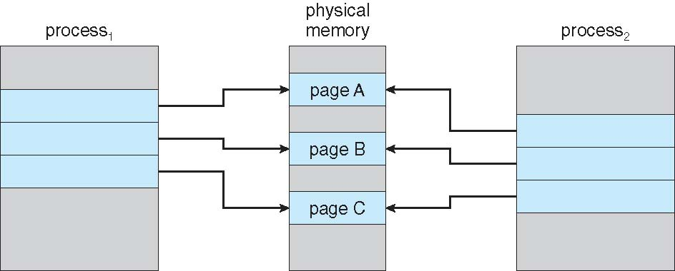
Before Process 1 Modifies Page C

Slide 23
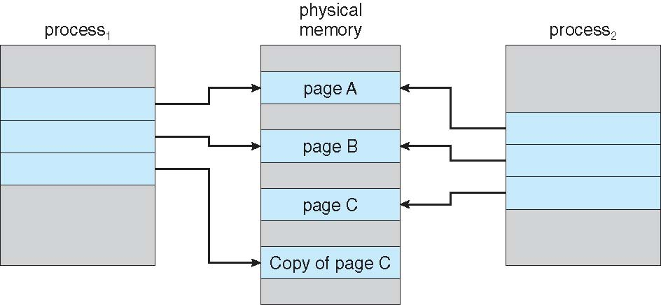
After Process 1 Modifies Page C

Slide 24
What Happens if There is no Free Frame?
Used up by process pages
Also in demand from the kernel, I/O buffers, etc
How much to allocate to each?
Page replacement – find some page in memory, but not really in use, page it out
Algorithm – terminate? swap out? replace the page?
Performance – want an algorithm which will result in minimum number of page faults
Same page may be brought into memory several times

Slide 25
Page Replacement
Prevent over-allocation of memory by modifying page-fault service routine to include page replacement
Use modify (dirty) bit to reduce overhead of page transfers – only modified pages are written to disk
Page replacement completes separation between logical memory and physical memory – large virtual memory can be provided on a smaller physical memory

Slide 26
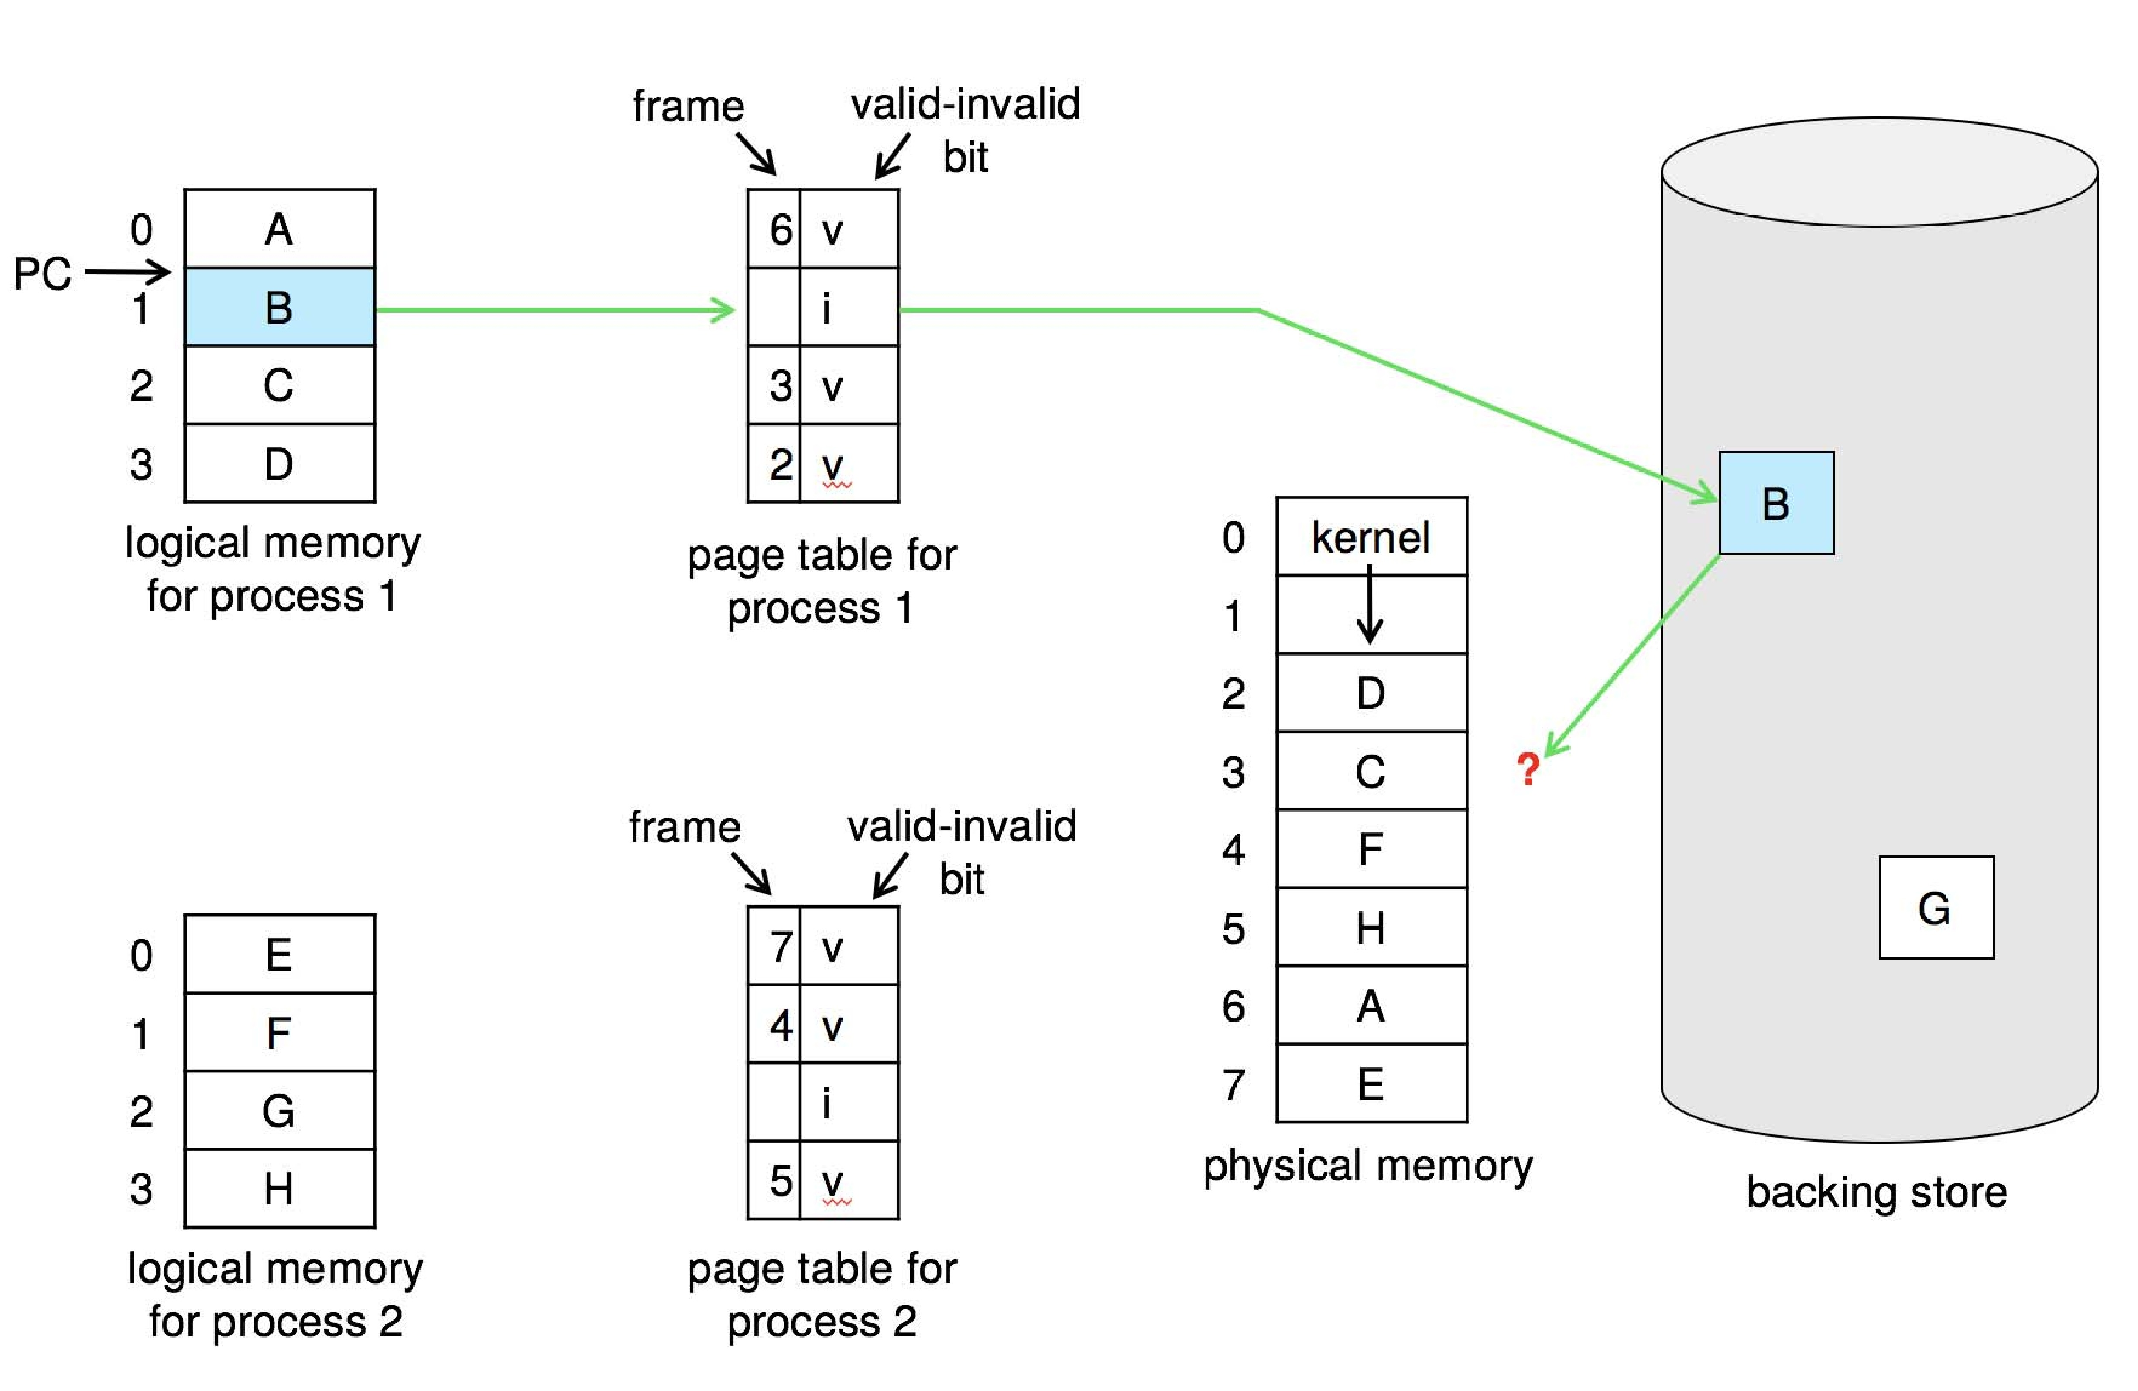
Need For Page Replacement

Slide 27
Basic Page Replacement
Find the location of the desired page on disk
Find a free frame: - If there is a free frame, use it - If there is no free frame, use a page replacement algorithm to select a victim frame - Write victim frame to disk if dirty
Bring the desired page into the (newly) free frame; update the page and frame tables
Continue the process by restarting the instruction that caused the trap
Note now potentially 2 page transfers for page fault – increasing EAT

Slide 28
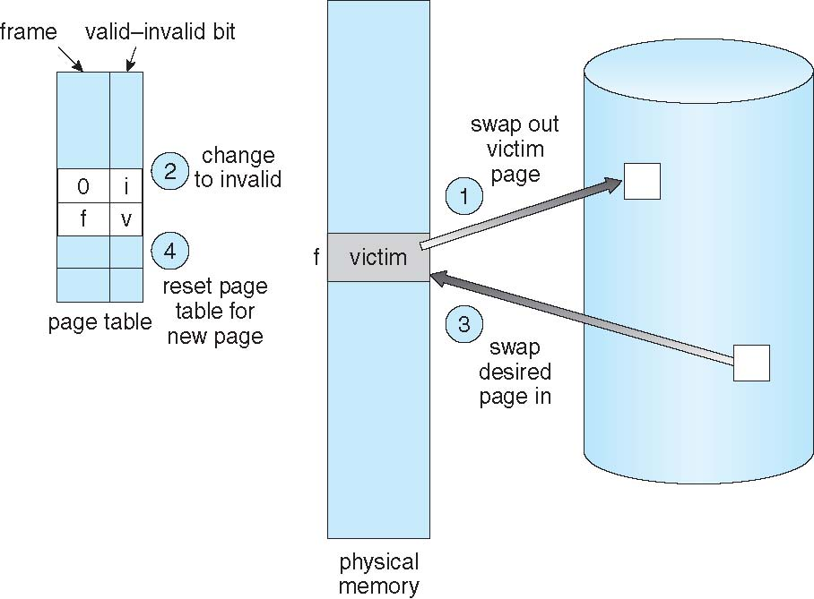
Page Replacement

Slide 29
Page and Frame Replacement Algorithms
Frame-allocation algorithm determines
How many frames to give each process
Which frames to replace
Page-replacement algorithm
Want lowest page-fault rate on both first access and re-access

Slide 30
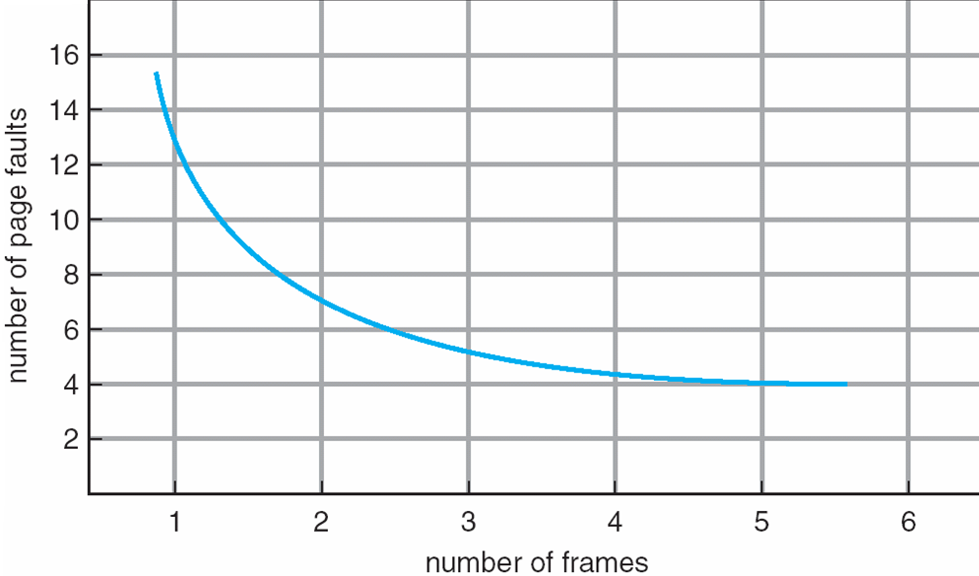
Graph of Page Faults Versus The Number of Frames

Slide 31
First-In-First-Out (FIFO) Algorithm
Reference string: 7,0,1,2,0,3,0,4,2,3,0,3,0,3,2,1,2,0,1,7,0,1
3 frames (3 pages can be in memory at a time per process)
Can vary by reference string: consider 1,2,3,4,1,2,5,1,2,3,4,5
Adding more frames can cause more page faults!
Belady’s Anomaly
How to track ages of pages?
Just use a FIFO queue
1
7
2
4 0 7
2
0
3
15 page faults
2 1 0
3
1
0
3 2 1

Slide 32
FIFO Page Replacement Example
Covered in Class

Slide 33
Least Recently Used (LRU) Algorithm
Use past knowledge rather than future
Replace page that has not been used in the most amount of time
Associate time of last use with each page

Slide 34
LRU Algorithm (Cont.)
Counter implementation
Every page entry has a counter; every time page is referenced through this entry, copy the clock into the counter
When a page needs to be changed, look at the counters to find smallest value
Search through table needed
Stack implementation
Keep a stack of page numbers in a double link form:
Page referenced:
move it to the top
requires 6 pointers to be changed
But each update more expensive
No search for replacement

Slide 35
LRU Algorithm Example
Covered in Class

Slide 36
Optimal Algorithm
Replace page that will not be used for longest period of time

Slide 37
Optimal Page Replacement Example
Covered in Class

Slide 39
LRU Approximation Algorithms
LRU needs special hardware and still slow
Reference bit
With each page associate a bit, initially = 0
When page is referenced bit set to 1
Replace any with reference bit = 0 (if one exists)
We do not know the order, however
Second-chance algorithm
Generally FIFO, plus hardware-provided reference bit
Clock replacement
If page to be replaced has
Reference bit = 0 -> replace it
reference bit = 1 then:
set reference bit 0, leave page in memory
replace next page, subject to same rules

Slide 40
Second Chance Algorithm
Covered in Class

Slide 41
Enhanced Second Chance Algo
1. (0, 0) neither recently used nor modified—best page to replace
2. (0, 1) not recently used but modified—not quite as good, because the page will need to be written out before replacement
3.(1, 0) recently used but clean—probably will be used again soon
4. (1, 1) recently used and modified—probably will be used again soon, and the page will be need to be written out to disk before it can be replaced

Slide 42
Enhance Second Chance
The major difference between ESC algorithm and the simpler SC algorithm is that here we give preference to those pages that have been modified in order to reduce the number of I/Os required.

Slide 43
Counting Algorithms
Keep a counter of the number of references that have been made to each page
LFU Algorithm: replaces page with smallest count. Problem arise when a page is heavily used during initial phase and then never used. Since it is heavily used it remains in memory even no longer needed.
MFU Algorithm: based on the argument that the page with the smallest count was probably just brought in and has yet to be used

Slide 44
Page-Buffering Algorithms
Keep a pool of free frames, always
Then frame available when needed, not found at fault time
Read page into free frame and select victim to evict and add to free pool
When convenient, evict victim
Possibly, keep list of modified pages
When backing store otherwise idle, write pages there and set to non-dirty
Possibly, keep free frame contents intact and note what is in them
If reference again before reused, no need to load contents again from disk
Generally useful to reduce penalty if wrong victim frame selected

Slide 45
Applications and Page Replacement
All of these algorithms have OS guessing about future page access
Some applications have better knowledge – i.e. databases
Memory intensive applications can cause double buffering
Operating system can given direct access to the disk, getting out of the way of the applications

Slide 46
Allocation of Frames
Each process needs minimum number of frames
Maximum of course is total frames in the system
Two major allocation schemes
fixed allocation
priority allocation

Slide 47
Fixed Allocation
Equal allocation – For example, if there are 100 frames (after allocating frames for the OS) and 5 processes.
Keep some as free frame buffer pool
Equal Allocation=Number of frames / number of processes
EA= 100/ 5 = 20 frames /process

Slide 48
Propotional Allocation
Proportional allocation – Allocate according to the size of process
Dynamic as degree of multiprogramming, process sizes change

Slide 49
Priority Allocation
Use a proportional allocation scheme using priorities rather than size
If process P_{i} generates a page fault,
select for replacement one of its frames
select for replacement a frame from a process with lower priority number

Slide 50
Global vs. Local Allocation
Global replacement – process selects a replacement frame from the set of all frames; one process can take a frame from another
But then process execution time can vary greatly
But greater throughput so more common
Local replacement – each process selects from only its own set of allocated frames
More consistent per-process performance
But possibly underutilized memory

Slide 51
Reclaiming Pages
A strategy to implement global page-replacement policy
All memory requests are satisfied from the free-frame list, rather than waiting for the list to drop to zero before we begin selecting pages for replacement,
Page replacement is triggered when the list falls below a certain threshold.
This strategy attempts to ensure there is always sufficient free memory to satisfy new requests.

Slide 52
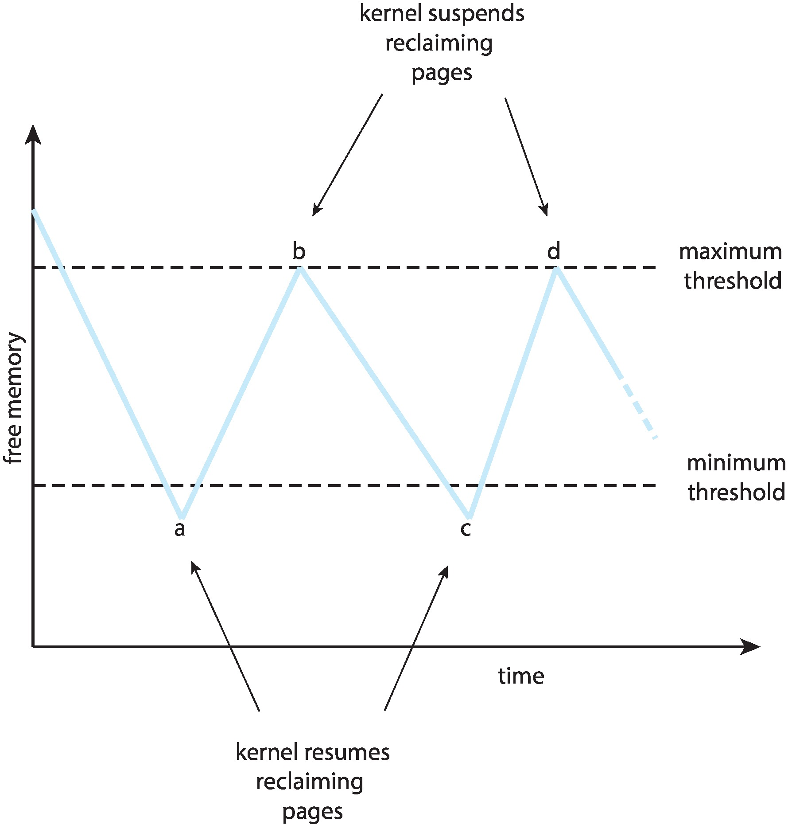
Reclaiming Pages Example

Slide 53
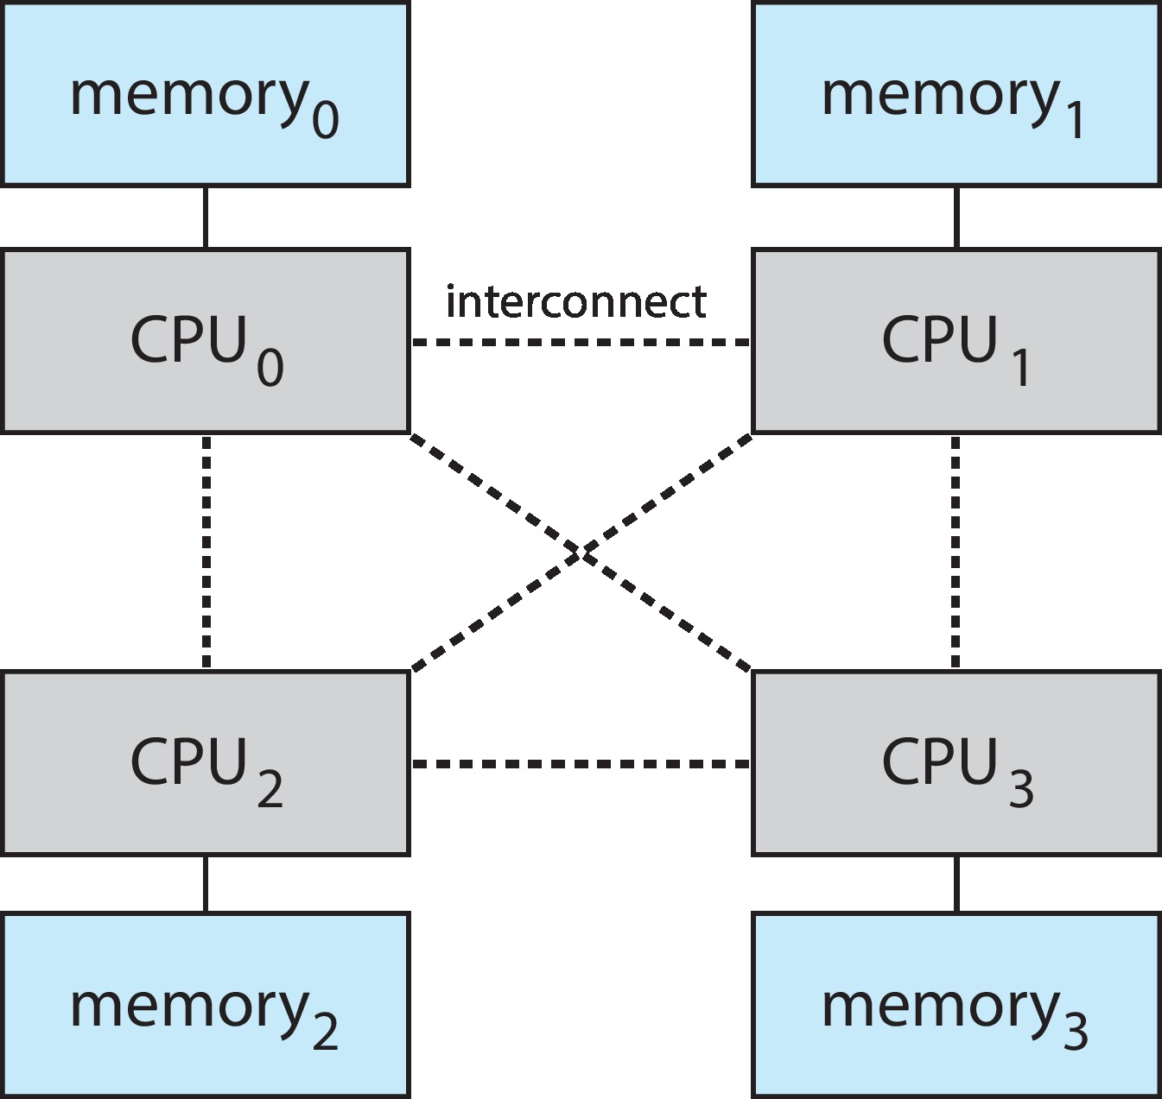
Non-Uniform Memory Access
So far, we assumed that all memory accessed equally
Many systems are NUMA – speed of access to memory varies
Consider system boards containing CPUs and memory, interconnected over a system bus
NUMA multiprocessing architecture

Slide 54
Non-Uniform Memory Access (Cont.)
Optimal performance comes from allocating memory “close to” the CPU on which the thread is scheduled
And modifying the scheduler to schedule the thread on the same system board when possible
Solved by Solaris by creating lgroups
Structure to track CPU / Memory low latency groups
Used my schedule and pager
When possible schedule all threads of a process and allocate all memory for that process within the lgroup

Slide 55
Thrashing
If a process does not have “enough” pages, the page-fault rate is very high
Page fault to get page
Replace existing frame
But quickly need replaced frame back
This leads to:
Low CPU utilization
Operating system thinking that it needs to increase the degree of multiprogramming
Another process added to the system
Thrashing ≡ a process is busy swapping pages in and out

Slide 56
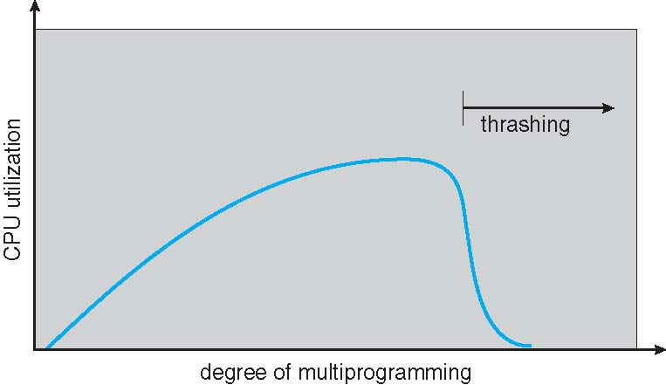
Thrashing (Cont.)

Slide 57
Demand Paging and Thrashing
Why does demand paging work? Locality model= set of pages used actively together
Process migrates from one locality to another
Localities may overlap
Why does thrashing occur? Σ size of locality > total memory size
Limit effects by using local or priority page replacement

Slide 58
Working-Set Model
Δ ≡ working-set window ≡ a fixed number of page references Example: 10,000 instructions
WSS_{i} (working set of Process P_{i}) = total number of pages referenced in the most recent Δ (varies in time)
if Δ too small will not encompass entire locality
if Δ too large will encompass several localities
if Δ = ∞ ⇒ will encompass entire program
D = Σ WSS_{i} ≡ total demand frames
Approximation of locality
if D > m ⇒ Thrashing
Policy if D > m, then suspend or swap out one of the processes

Slide 59
Keeping Track of the Working Set
Approximate with interval timer + a reference bit
Example: Δ = 10,000
Timer interrupts after every 5000 time units
Keep in memory 2 bits for each page
Whenever a timer interrupts copy and sets the values of all reference bits to 0
If one of the bits in memory = 1 ⇒ page in working set
Why is this not completely accurate?
Improvement = 10 bits and interrupt every 1000 time units

Slide 60
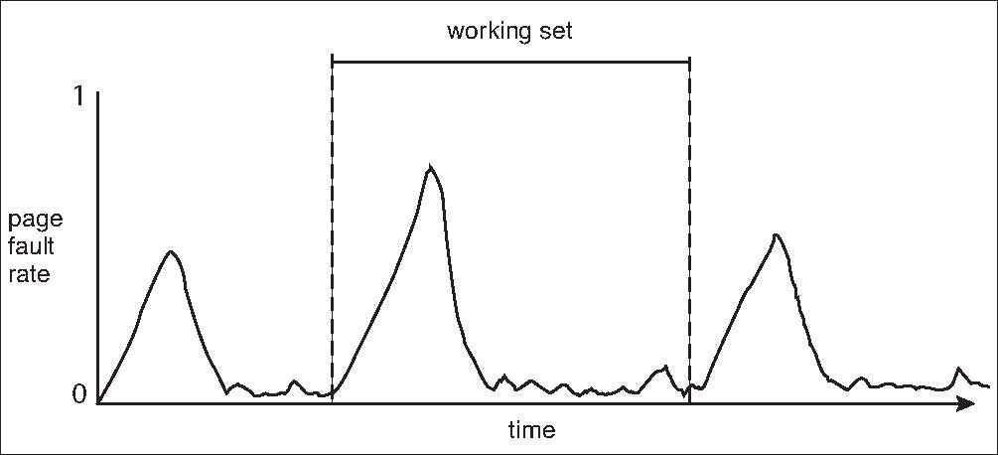
Working Sets and Page Fault Rates
Direct relationship between working set of a process and its page-fault rate
Working set changes over time
Peaks and valleys over time

Slide 61
Allocating Kernel Memory
Treated differently from user memory
Often allocated from a free-memory pool
Kernel requests memory for structures of varying sizes
Some kernel memory needs to be contiguous
I.e. for device I/O
1. Buddy System Allocator
2. Slab Allocator

Slide 62
Buddy System
Allocates memory from fixed-size segment consisting of physically-contiguous pages
Memory allocated using power-of-2 allocator
Satisfies requests in units sized as power of 2
Request rounded up to next highest power of 2
When smaller allocation needed than is available, current chunk split into two buddies of next-lower power of 2
Continue until appropriate sized chunk available
For example, assume 256KB chunk available, kernel requests 21KB
Split into A_{L} _{and} A_{r} of 128KB each
One further divided into B_{L} and B_{R} of 64KB
One further into C_{L} and C_{R} of 32KB each – one used to satisfy request
Advantage – quickly coalesce unused chunks into larger chunk
Disadvantage - fragmentation

Slide 63
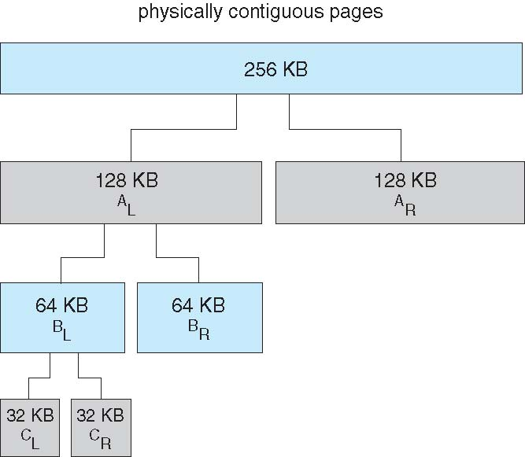
Buddy System Allocator

Slide 64
Slab Allocator
Slab is one or more physically contiguous pages
Cache consists of one or more slabs
Single cache for each unique kernel data structure
Each cache filled with objects – instantiations of the data structure
When cache created, filled with objects marked as free
When structures stored, objects marked as used
If slab is full of used objects, next object allocated from empty slab
Benefits include no fragmentation, fast memory request satisfaction

Slide 65
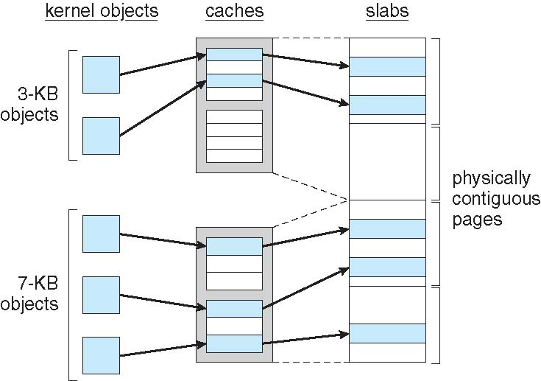
Slab Allocation

Slide 66
Slab Allocator in Linux
For example process descriptor is of type struct task_struct
Approx 1.7KB of memory
New task -> allocate new struct from cache
Will use existing free struct task_struct
Slab can be in three possible states
Full – all used
Empty – all free
Partial – mix of free and used
Upon request, slab allocator
Uses free struct in partial slab
If none, takes one from empty slab
If no empty slab, create new empty

Slide 67
Slab Allocator in Linux (Cont.)
Slab started in Solaris, now wide-spread for both kernel mode and user memory in various OSes
Linux 2.2 had SLAB, now has both SLOB and SLUB allocators
SLOB for systems with limited memory
Simple List of Blocks – maintains 3 list objects for small, medium, large objects
SLUB is performance-optimized SLAB removes per-CPU queues, metadata stored in page structure

Slide 68
Other Considerations -- Prepaging
Prepaging
To reduce the large number of page faults that occurs at process startup
Prepage all or some of the pages a process will need, before they are referenced
But if prepaged pages are unused, I/O and memory was wasted
Assume s pages are prepaged and α of the pages is used
Is cost of s * α save pages faults > or < than the cost of prepaging s * (1- α) unnecessary pages?
α near zero ⇒ prepaging loses

Slide 69
Other considerations – Page Size
Page size selection must take into consideration:
Fragmentation
Page table size
Resolution
I/O overhead
Number of page faults
Locality
TLB size and effectiveness
Always power of 2, usually in the range 2¹² (4,096 bytes) to 2²² (4,194,304 bytes)
On average, growing over time

Slide 70
Other considerations – TLB Reach
TLB Reach - The amount of memory accessible from the TLB
TLB Reach = (TLB Size) X (Page Size)
Ideally, the working set of each process is stored in the TLB
Otherwise there is a high degree of page faults
Increase the Page Size
This may lead to an increase in fragmentation as not all applications require a large page size
Provide Multiple Page Sizes
This allows applications that require larger page sizes the opportunity to use them without an increase in fragmentation

Slide 71
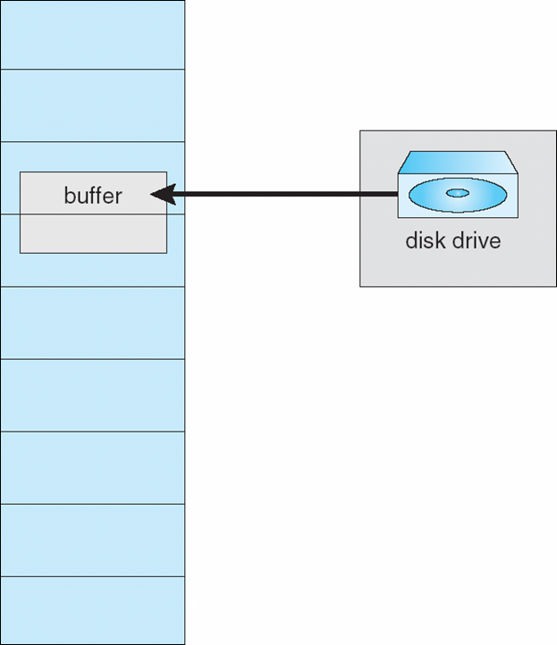
I/O interlock
I/O Interlock – Pages must sometimes be locked into memory
Consider I/O - Pages that are used for copying a file from a device must be locked from being selected for eviction by a page replacement algorithm
Pinning of pages to lock into memory

